Slide 1

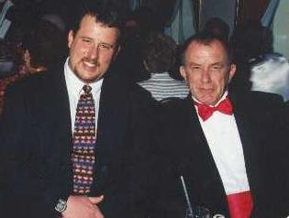
Exposure CS 2022
for CS1
Chapter 8 Section 6 Slides
Combining Repetition with
Traditional Graphics
PowerPoint Presentation
created by:
Mr. John L. M. Schram
and Mr. Leon Schram
Authors of Exposure
Computer Science

Slide 2
Section 8.6
Using Repetition with
Traditional Graphics

Slide 3
1 # RepetitionWithGraphics04.py 2 # This program shows how a <for> loop can also be 3 # used with traditional graphics. This program draws 4 # vertical lines because <x1> and <x2> are always equal. 5
6 7 from Graphics import * 8 9 beginGrfx(1300,700) 10 11 x1 = 100 12 y1 = 100 13 x2 = 100 14 y2 = 600 15 16 for k in range(56): 17 drawLine(x1,y1,x2,y2) 18 x1 += 20 19 x2 += 20 20 21 endGrfx()

Slide 4
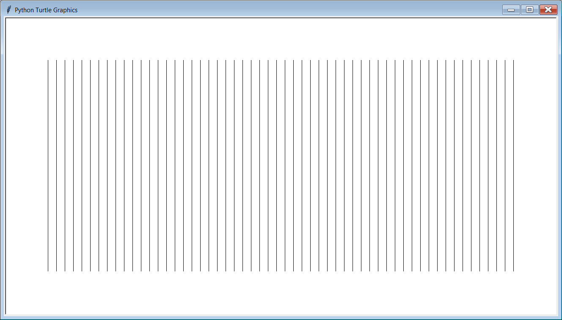
1 # RepetitionWithGraphics04.py 2 # This program shows how a <for> loop can also be 3 # used with traditional graphics. This program draws 4 # vertical lines because <x1> and <x2> are always equal. 5
6 7 from Graphics import * 8 9 beginGrfx(1300,700) 10 11 x1 = 100 12 y1 = 100 13 x2 = 100 14 y2 = 600 15 16 for k in range(56): 17 drawLine(x1,y1,x2,y2) 18 x1 += 20 19 x2 += 20 20 21 endGrfx()

Slide 5
1 # RepetitionWithGraphics05.py 2 # This program draws horizontal lines because 3 # <y1> and <y2> are always equal. 4
5 6 from Graphics import * 7 8 beginGrfx(1300,700) 9 10 x1 = 100 11 y1 = 100 12 x2 = 1200 13 y2 = 100 14 15 for k in range(26): 16 drawLine(x1,y1,x2,y2) 17 y1 += 20 18 y2 += 20 19 20 endGrfx()

Slide 6
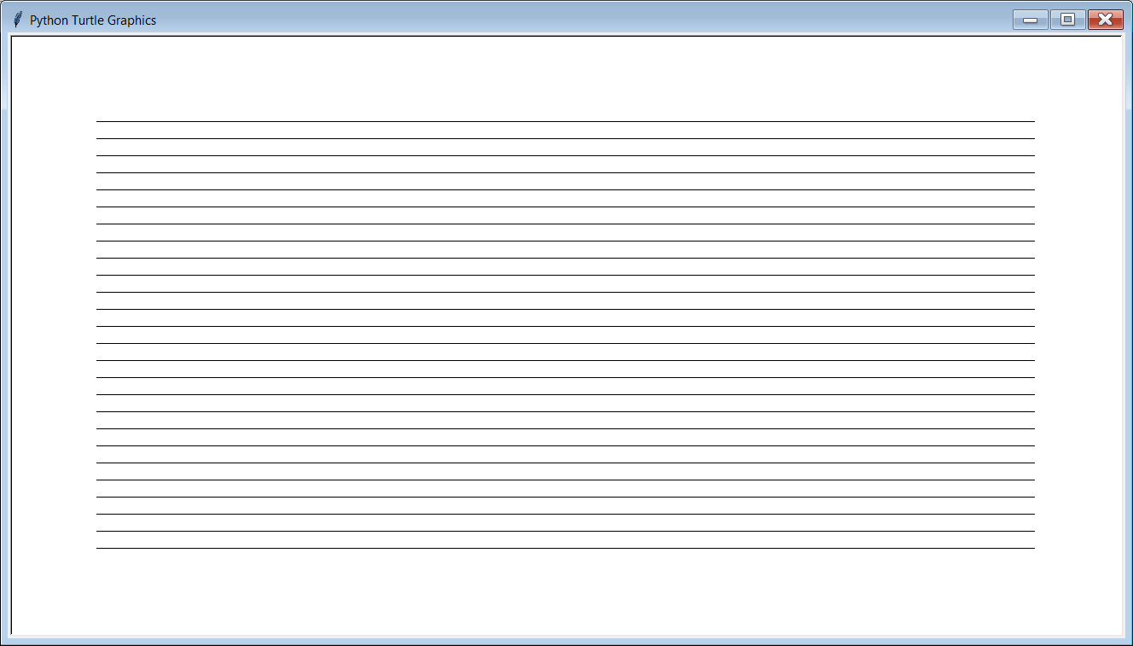
1 # RepetitionWithGraphics05.py 2 # This program draws horizontal lines because 3 # <y1> and <y2> are always equal. 4
5 6 from Graphics import * 7 8 beginGrfx(1300,700) 9 10 x1 = 100 11 y1 = 100 12 x2 = 1200 13 y2 = 100 14 15 for k in range(26): 16 drawLine(x1,y1,x2,y2) 17 y1 += 20 18 y2 += 20 19 20 endGrfx()

Slide 7
1 # RepetitionWithGraphics06.py 2 # This program draws parallel diagonal lines 3 # and changes all 4 variables. 4
5 6 from Graphics import * 7 8 beginGrfx(1300,700) 9 10 x1 = 100 11 y1 = 50 12 x2 = 300 13 y2 = 350 14 15 for k in range(31): 16 drawLine(x1,y1,x2,y2) 17 x1 += 30 18 x2 += 30 19 y1 += 10 20 y2 += 10 21 22 endGrfx()

Slide 8
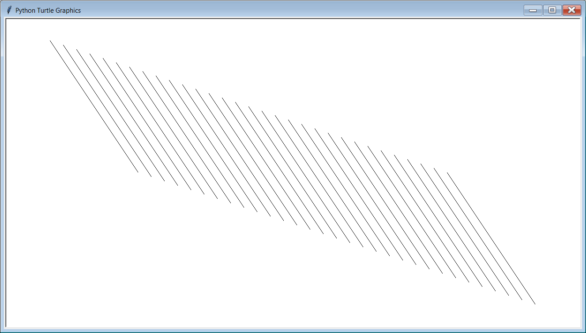
1 # RepetitionWithGraphics06.py 2 # This program draws parallel diagonal lines 3 # and changes all 4 variables. 4
5 6 from Graphics import * 7 8 beginGrfx(1300,700) 9 10 x1 = 100 11 y1 = 50 12 x2 = 300 13 y2 = 350 14 15 for k in range(31): 16 drawLine(x1,y1,x2,y2) 17 x1 += 30 18 x2 += 30 19 y1 += 10 20 y2 += 10 21 22 endGrfx()

Slide 9
1 # RepetitionWithGraphics07.py 2 # This program demonstrates several lines with the same 3 # starting point. In this case the (x1,y1) coordinate 4 # stays fixed while the (x2,y2) point changes. 5 6 7 from Graphics import * 8 9 beginGrfx(1300,700) 10 11 x1 = 100 12 y1 = 100 13 x2 = 1200 14 y2 = 100 15 16 for k in range(26): 17 drawLine(x1,y1,x2,y2) 18 x2 -= 35 19 y2 += 20 20 21 endGrfx()

Slide 10
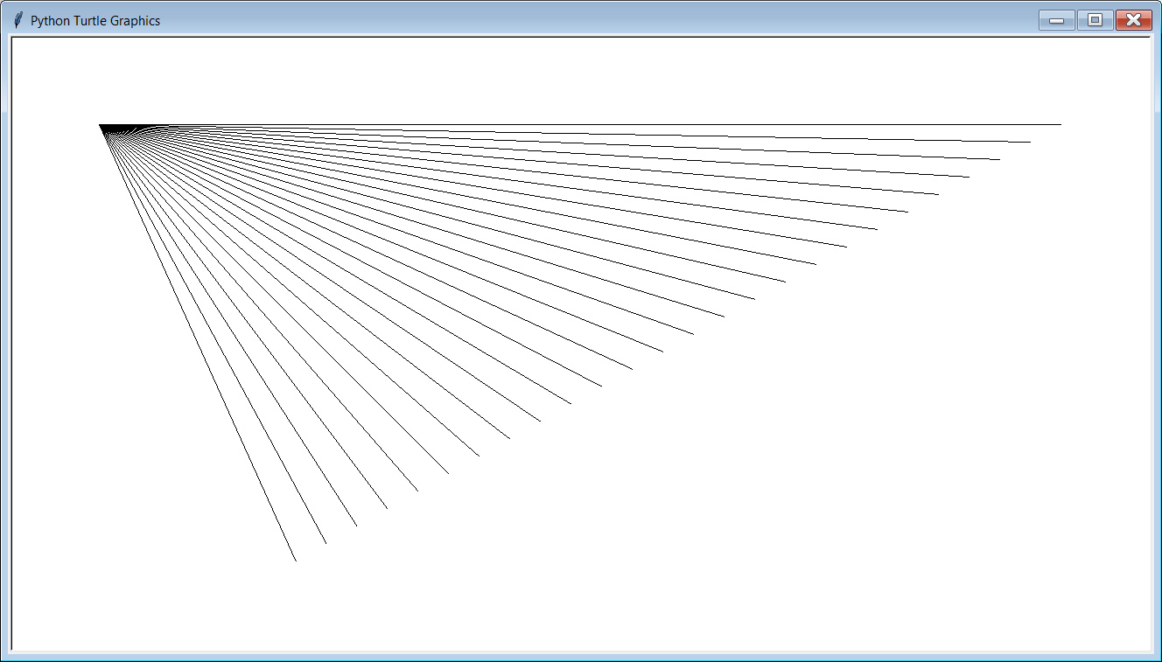
1 # RepetitionWithGraphics07.py 2 # This program demonstrates several lines with the same 3 # starting point. In this case the (x1,y1) coordinate 4 # stays fixed while the (x2,y2) point changes. 5 6 7 from Graphics import * 8 9 beginGrfx(1300,700) 10 11 x1 = 100 12 y1 = 100 13 x2 = 1200 14 y2 = 100 15 16 for k in range(26): 17 drawLine(x1,y1,x2,y2) 18 x2 -= 35 19 y2 += 20 20 21 endGrfx()

Slide 11
1 # RepetitionWithGraphics08.py 2 # This program demonstrates several ovals. 3 # All of the ovals have the same center and vertical 4 # radius. The horizontal radius keeps growing. 5 # NOTE: There may be a little delay in the display 6 # of the output. 7 8 9 from Graphics import * 10 11 beginGrfx(1300,700) 12 13 x = 650 14 y = 350 15 hr = 50 16 vr = 150 17 18 for k in range(30): 19 drawOval(x,y,hr,vr) 20 hr += 20 21 22 endGrfx()

Slide 12
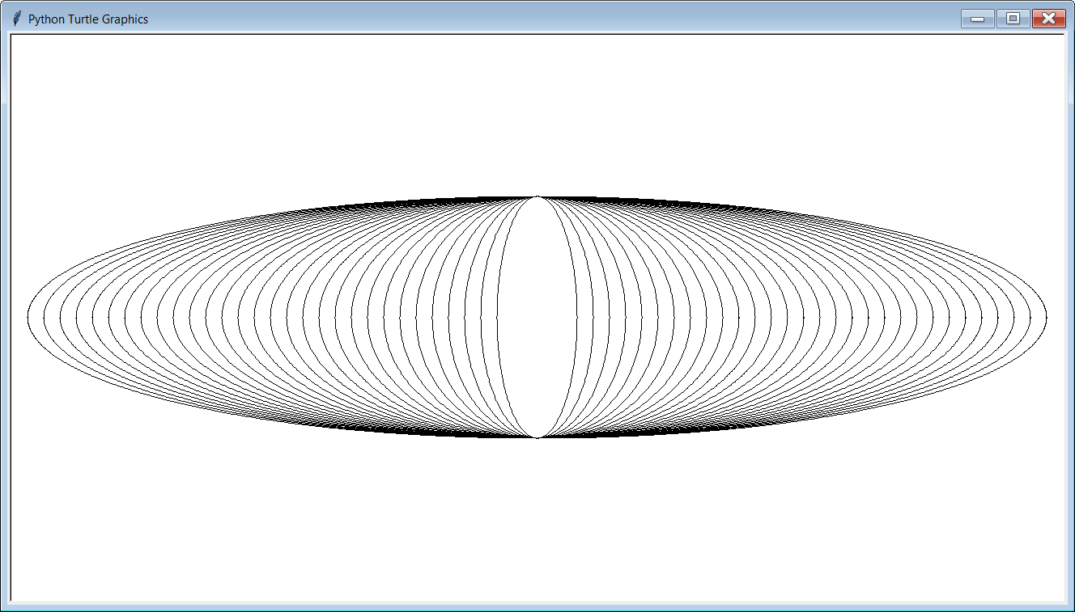
1 # RepetitionWithGraphics08.py 2 # This program demonstrates several ovals. 3 # All of the ovals have the same center and vertical 4 # radius. The horizontal radius keeps growing. 5 # NOTE: There may be a little delay in the display 6 # of the output. 7 8 9 from Graphics import * 10 11 beginGrfx(1300,700) 12 13 x = 650 14 y = 350 15 hr = 50 16 vr = 150 17 18 for k in range(30): 19 drawOval(x,y,hr,vr) 20 hr += 20 21 22 endGrfx()

Slide 13
1 # RepetitionWithGraphics09.py 2 # This program demonstrates several concentric stars. 3 # Each new star has 2 more points and double the radius 4 # of the previous star. 5
6 7 from Graphics import * 8 9 beginGrfx(700,700) 10 11 x = 350 12 y = 350 13 r = 20 14 p = 6 15 16 for k in range(5): 17 drawStar(x,y,r,p) 18 p += 2 19 r *= 2 20 21 endGrfx()

Slide 14
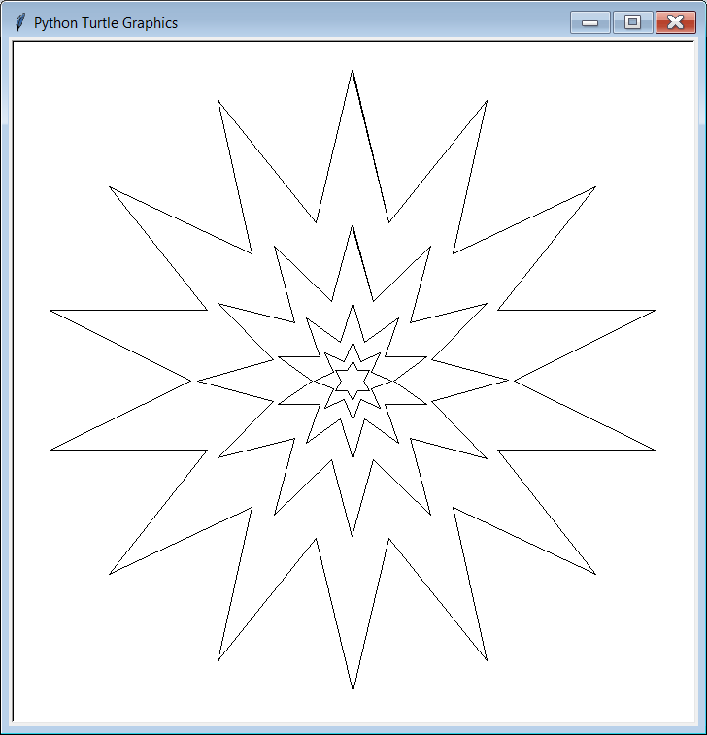
1 # RepetitionWithGraphics09.py 2 # This program demonstrates several concentric stars. 3 # Each new star has 2 more points and double the radius 4 # of the previous star. 5
6 7 from Graphics import * 8 9 beginGrfx(700,700) 10 11 x = 350 12 y = 350 13 r = 20 14 p = 6 15 16 for k in range(5): 17 drawStar(x,y,r,p) 18 p += 2 19 r *= 2 20 21 endGrfx()

Slide 15
1 # RepetitionWithGraphics10.py 2 # This program is similar to the previus program, but now 3 # the stars are filled in with solid colors. It also shows 4 # that <setColor> can be used with a single int parameter: 5 # 0=Black, 1=Red, 2=Green, 3=Blue, 4=Orange, 5=Cyan, etc. 6 # Note that the radius <r> and number of points <p> variables 7 # are counting in the opposite direction from before. 8
9 10 from Graphics import * 11 12 beginGrfx(700,700) 13 14 x = 350 15 y = 350 16 r = 320 17 p = 14 18 c = 1 19 20 for k in range(5): 21 setColor(c) 22 fillStar(x,y,r,p) 23 p -= 2 24 r //= 2 25 c += 1 26 endGrfx()

Slide 16
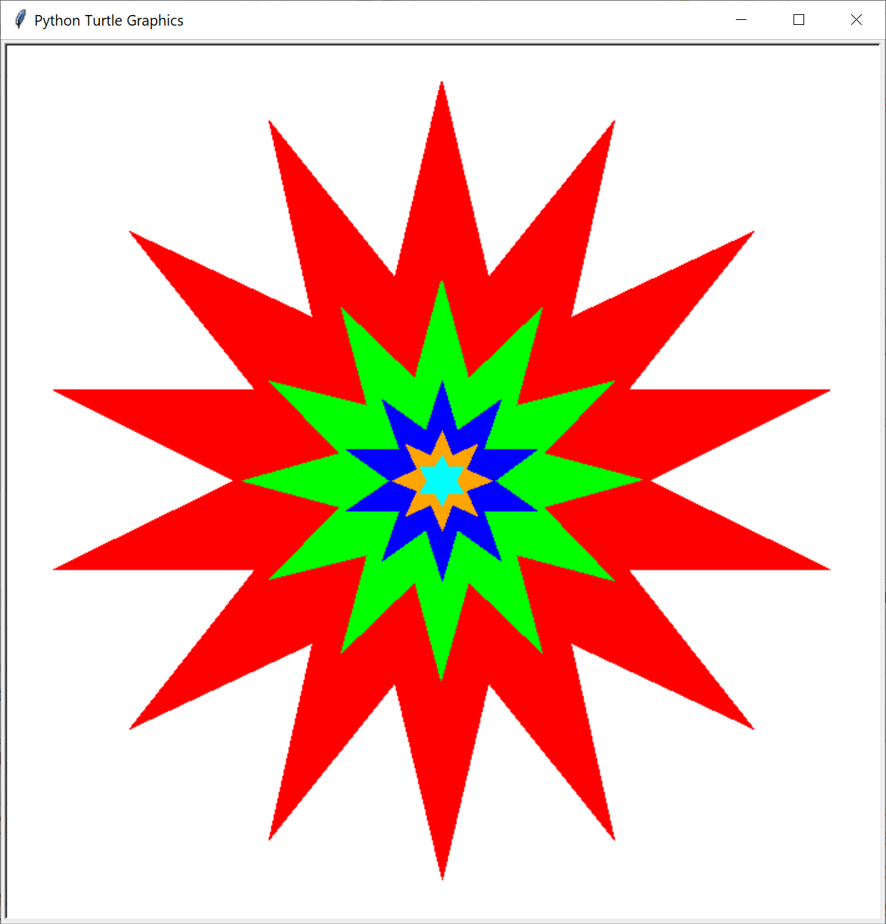
1 # RepetitionWithGraphics10.py 2 # This program is similar to the previus program, but now 3 # the stars are filled in with solid colors. It also shows 4 # that <setColor> can be used with a single int parameter: 5 # 0=Black, 1=Red, 2=Green, 3=Blue, 4=Orange, 5=Cyan, etc. 6 # Note that the radius <r> and number of points <p> variables 7 # are counting in the opposite direction from before. 8
9 10 from Graphics import * 11 12 beginGrfx(700,700) 13 14 x = 350 15 y = 350 16 r = 320 17 p = 14 18 c = 1 19 20 for k in range(5): 21 setColor(c) 22 fillStar(x,y,r,p) 23 p -= 2 24 r //= 2 25 c += 1 26 endGrfx()

Slide 17
Lab 8B
What you saw in the past 7 program examples relates directly to what
you will be doing in Lab 8B.

